Slide 1
Life-Changing Science Discoveries
Prepared by Bogdan Sklyar

Slide 2
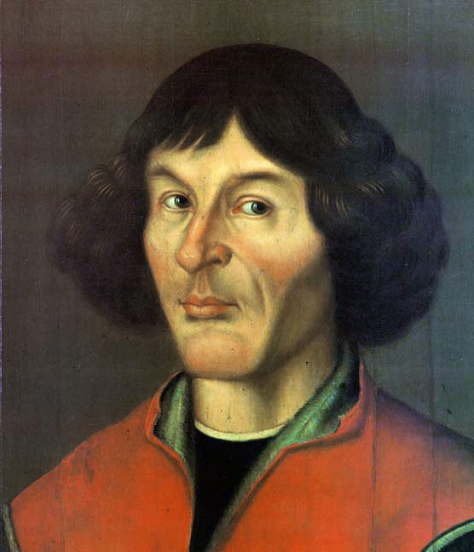
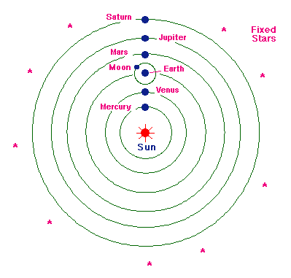
The Copernican System
Nicolaus Copernic

Slide 3
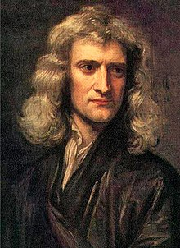
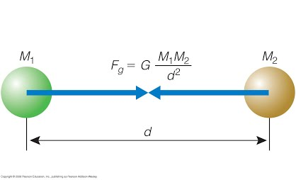
Gravity
Isaac newton

Slide 4
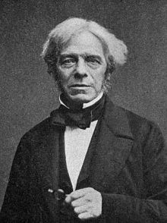
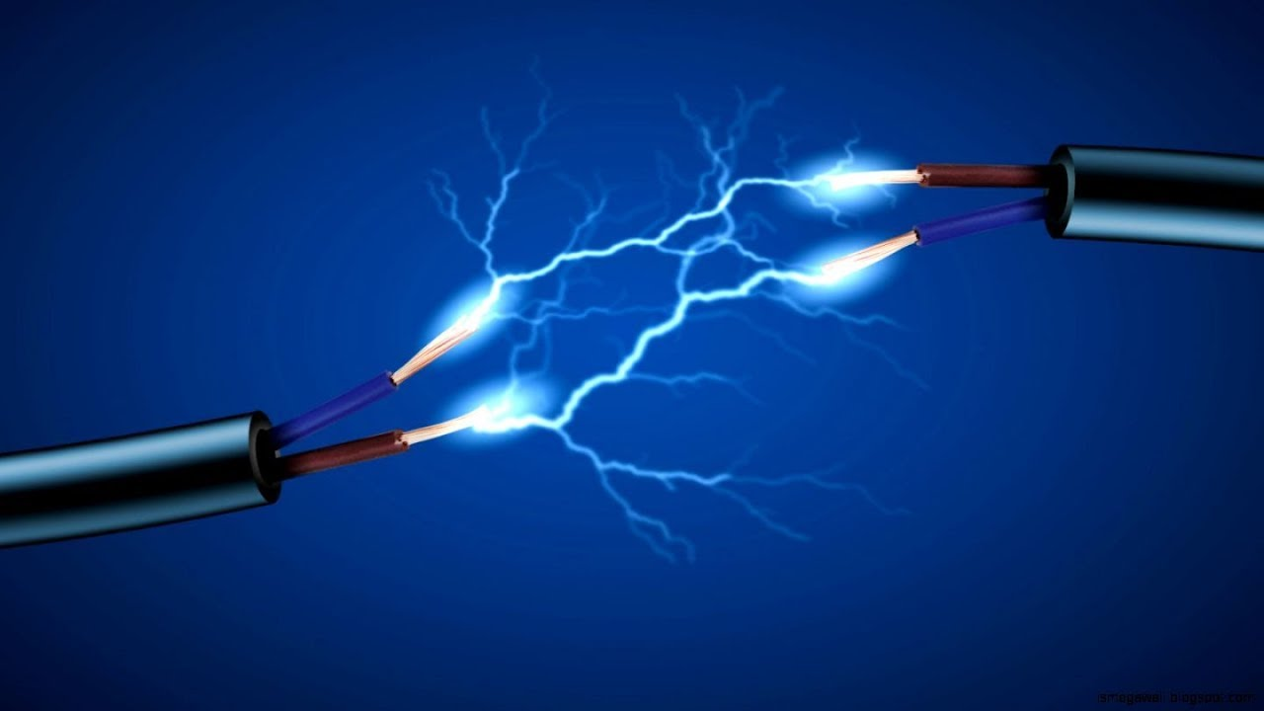
Electricity
Michael Faraday

Slide 5
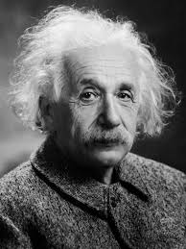
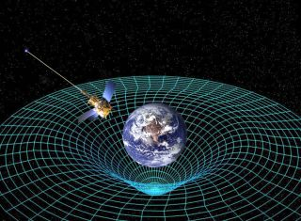
Theory of Relativity
Albert Einstein

Slide 6
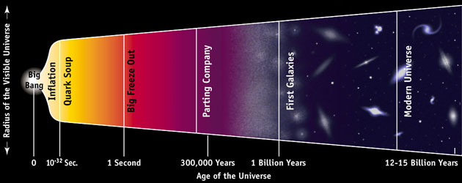
The Big Bang Theory

Slide 7
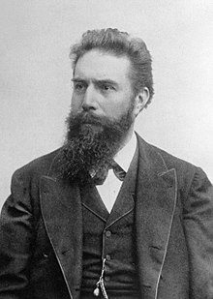
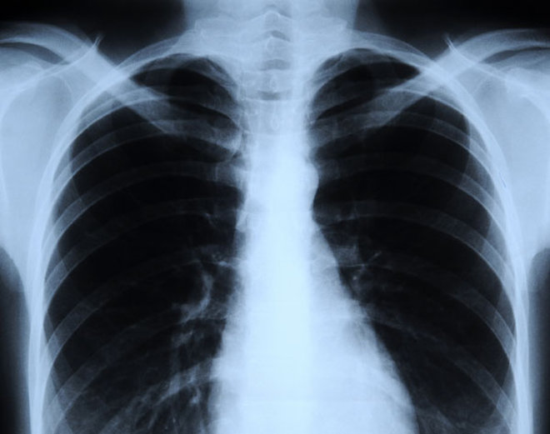
X-Rays
Wilhelm Roentgen

Slide 8
Thank you for attention!

